Slide 1


Data-Centric Security
Digital Signatures & Encryption
OGC API- Features &
Proxies
STANAG
Notes:
OGC Testbed-15 Data Centric Security task reserached the current state of security in protecting data in a geospatial environment. We examined the use of encrypted containers in combination with geospatial data using the encoding for an OGC API for Features and the Web Feature Service (WFS) FeatureCollection structure.

Slide 2
API Support
Security classification (additional metadata fields)
Representation of data source/origin
Tampering
Implementations that ensure “all-time” encryption
Notes:
How to mark and encode collections
Avoid tampering with Encryption and Digital Signatures
End to end encryption for storage to client

Slide 3
SECURED
CONTAINER
NATO STANAG
4778, 4774
FEATURE
COLLECTION
STANAG 4778: Information on Standard Metadata Binding
STANAG 4774: Confidentiality Metadata Label Syntax permit the sharing of sensitive information between allies
Notes:
We looked at the use of encrypted container formats such as NATO STANAG 4778 "Information on standard Metadata Binding" with metadata as defined in NATO STANAG 4774 "Confidentiality Metadata Label Syntax" to permit the sharing of sensitive information between allies.

Slide 4
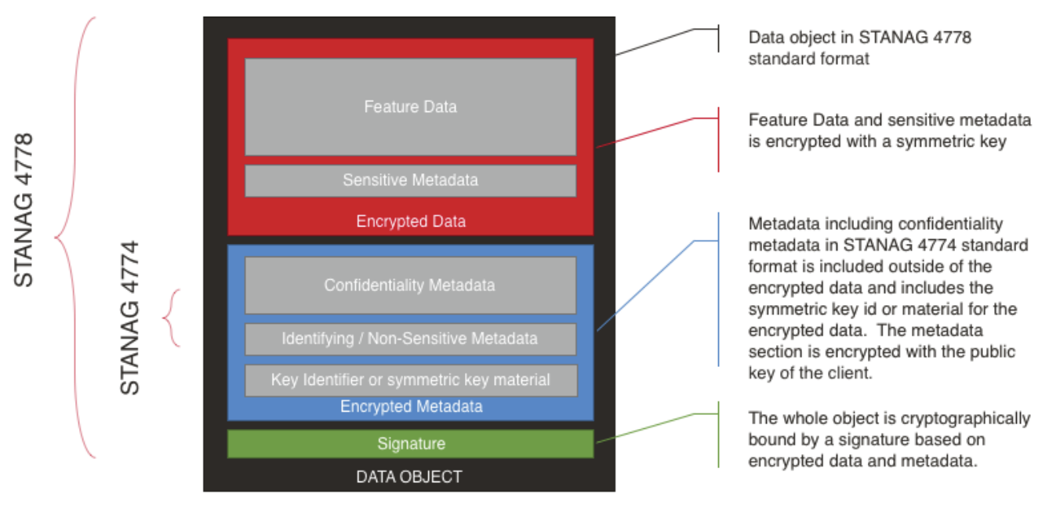
STANAG 4778 and 4774
Notes:
We looked at ways to encrypt portions of the collections so for example, the Header Metadata could be analyzed separately from the body or geospatial features that would always stay safely encrypted.

Slide 5
Implementation Alternatives
From a “vanilla” FeatureCollection to DCS
DCS Objects inside a FeatureCollection

Slide 6
TB15 DCS Demonstration Users and Features
Demo users and their fictitious clearance
Feature types and their fictitious classification
Username | Clearance
jane | Top secret
bob | secret
alice | classified
joe | unclassified
Feature type | Classification
poly_landmarks | top secret
poi | secret
tiger_roads | classified
states | unclassified
+
=
Username | Action | Feature type
jane | read | poly_landmarks, poi, tiger_roads, states
bob | read | poi, tiger_roads, states
alice | read | tiger_roads
joe | read | states

Slide 7
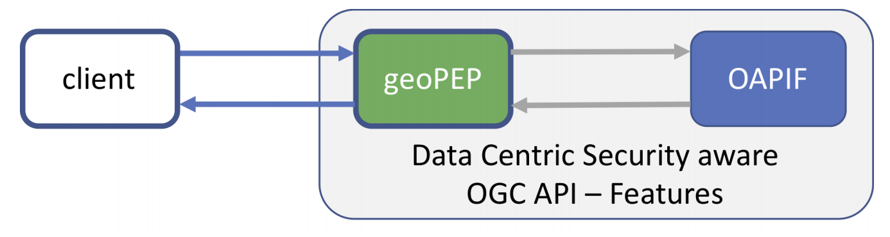
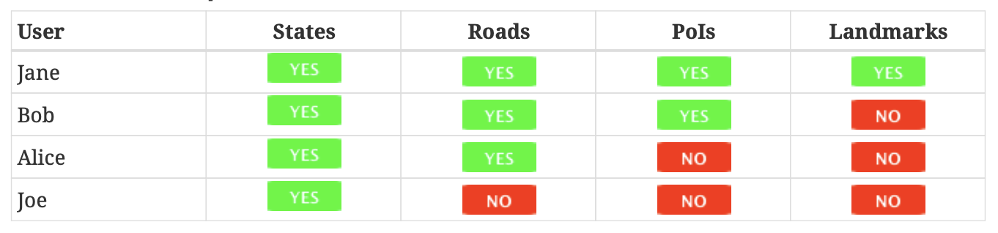

Slide 8
Disaster Access Policy for Jane
Jane has the clearance to fetch feature type tiger_roads
If Jane submits a geo-location, her clearance is overwritten and the returned features are inside the (disaster) area.
Jane outside (disaster) area before 12:00UTC
Jane inside (disaster) area before 12:00UTC
https://ogc.secure-dimensions.com/rest/services/DCS/collections/tiger_roads/items?f=stanag&access_token=
https://ogc.secure-dimensions.com/rest/services/DCS/collections/tiger_roads/items?f=stanag&subjectlocation=CRS=EPSG:4326;POINT(40.75%20-74.00)&access_token=

Slide 9
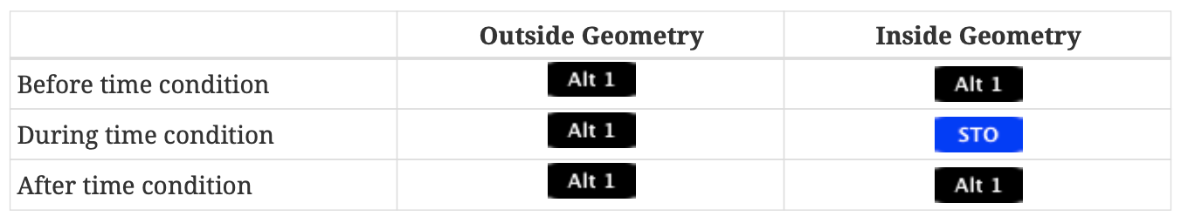
Spatio-Temporal Overrides
Joe has no clearance to fetch feature type tiger_roads
If Joe submits a geo-location, his clearance is overwritten and the returned features are inside the (disaster) area.
Joe has no clearance to fetch feature type tiger_roads
If Joe’s request is outside the (disaster) time window, his clearance is *not* overwritten. Geolocation has no effect!
Notes:
Grant or Limit access based upon Spatial and Temporal bounding boxes that are set into policies.
First example, Joe is inside the Area of Interest (both Geography and Time). This grants him access.
If he is outside the time window, he is denied access

Slide 10
Encountered Challenges
No support for NATO standards in current code lists
STANAG 4778 is a container format (encrypted + metadata)
Two encodings to be specified
Container
Content of container
STANAG 4778 does not handle mix of Data Centric Security formats
Collections with combined DCS formats not supported
Key management
API not aware of any keys (even public keys!)
API cannot act on data, but only forward (no filtering etc. possible)
Digital signatures missing in current WFS FeatureCollection scheme (CR #614)
Notes:
?f=stanag
the OGC API set of standards needs a way to specify both the container encoding and the format of the data in the container. Which, of course they could be different
One of the issues that different DCS formats may expose in the future is how to express a feature collection where items could be of different DCS formats.
No Keys in first alternative and the features were stored in the clear. In the final alternative, we did have the features stored and returned encrypted Currently there are no markings in the service to specify whether the metadata is encrypted with the public key of the client or if the metadata contains the key for the sensitive encrypted feature data.
The final issue is that of Digitial Signatures. Including a digital signature in a WFS Feature collection makes the entire collection invalid.

Slide 11
Results
3 scenarios demonstrated
Recommendations for
Digital signatures
Media types for STANAGs
Future work:
Key management
Sophisticated authentication and authorization schemes
How to search an encrypted database?
Consider TDF (Trusted Data Format) and flavors
Future Standards Program work:
Container formats (multi-encodings)
Digital signatures

